Slide 1
The Art Of Data Visualization
A SEMINAR REPORT
Submitted by
Manoj H. Yadav
Roll No. 43
in partial fulfillment for the award of the degree
of
M.Sc. Data Science and Artificial intelligence
RAMNIRANJAN JHUNJHUNWALA COLLEGE OF ART’S, SCIENCE & COMMERCE (AUTONOMOUS), GHATKOPAR (W)
JUNE 2021

Slide 2
Table of contents
Chapter No. | Title |  | Page No.
i | About |  | 04
ii | Design Principle |  | 06
iii | Figure |  | 08
 | a | Chart Suggestion
 | b | Addition Graph Suggestion
 | c | Combing Data Visualization methods
iv | Types of Data Visualization |  | 11
v | Data Visualization Tools |  | 15
vi | References |  | 25

Slide 3
The Art of Data Visualization

Slide 4
About
Data visualization is the art of providing insights with the aid of some type of visual representation , such as charts, graphs, or more complex forms of visualizations like dashboards.
Usually, the process involves various data visualization software – top data visualization tools such as Tableau, Power BI, or Python, and R on the programming end.
Investing time in learning data visualization techniques is worthwhile, as data visualization is becoming one of the most sought out fields in data science overall. Moreover, excellent data visualization skills are high-in-demand across a myriad of businesses and industries and open the door to many rewarding career opportunities.

Slide 5
What is Data visualization
Data visualization is the graphical representation of information and data. By using visual elements like charts, graphs, and maps, data visualization tools provide an accessible way to see and understand trends, outliers, and patterns in data.
In the world of Big Data, data visualization tools and technologies are essential to analyze massive amounts of information and make data-driven decisions.
Data visualization is another form of visual art that grabs our interest and keeps our eyes on the message.
Common general types of data visualization:
1. Charts
2. Tables
3. Graphs
4. Maps
5. Infographics
6. Dashboards

Slide 6
More specific examples of methods to visualize data:
1. Area Charts 10. Matrix
2. Bar chart 11. Network
3. Box-and-whisker Plots 12. Radial Tree
4. Bubble Cloud 13. Scatter Plot (2D or 3D)
5. Dot Distribution Map 14. Treemap etc.
6. Gantt Chart
7. Heat Map
8. Highlight Table
9. Histogram

Slide 7
Data visualization is comprised of a set of tools and techniques to create graphs (also called charts or diagrams) that, when used the right way, are extremely powerful. It is not about flashy 3-dimensional rainbow graphs. Data visualization is about being simple and representing data effectively.
Before considering design principles, there are important layers to be covered in preparation for the design layer.
1. Know the Data
2. Know the Message
3. Know the Audience
4. Know the Options
1. Know the Data :- What data types are in the data set? Are the variables mostly categorical, e.g., regions and departments? Do the data have geospatial variables, such as country, city, address or postal codes? What about dates? What are the quantitative variables? Is the categorical data nominal, ordinal, hierarchical or interval (≥ 70 points, < 70 and ≥ 50 points, and < 50) in nature?
Understating the data types can aid in selecting the best graph to visualize the data.

Slide 8
2. Know the Message :- What is being conveyed? Is the purpose to find the story the data are telling or simply to provide an explanation of a known issue?
understood what the data are saying and when that message is ready to be communicated to the audience.
3. Know the Audience :- Knowing the audience goes a long way toward making a connection and maximizing the chances that management will understand and retain the information being conveyed. What experience, skill and understanding of the subject will the audience members have? What is their ability to focus? How interested are they?
Most audiences are used to plain bar, line and pie charts. Bar charts can be useful to convey information, but it may help to provide the audience with some initial attention-grabbing visuals
4. Know the Options :- This is one of the most interesting parts of data visualization choosing the correct graph for the data type and relationships in the data set.

Slide 9
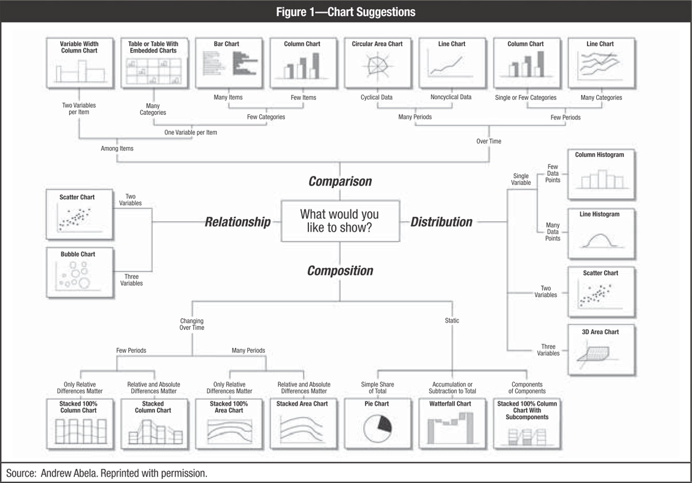

Slide 10
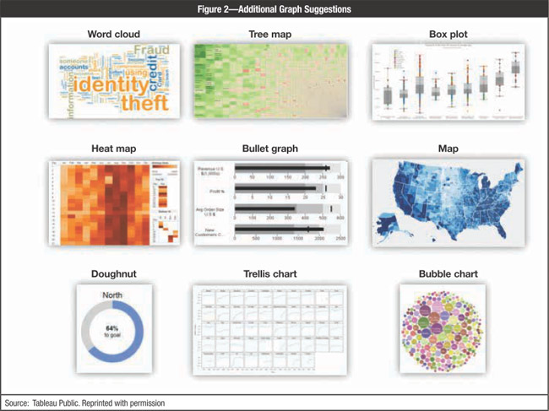

Slide 11
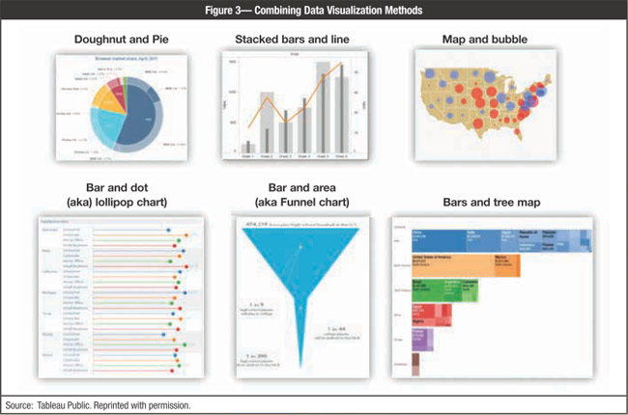

Slide 12
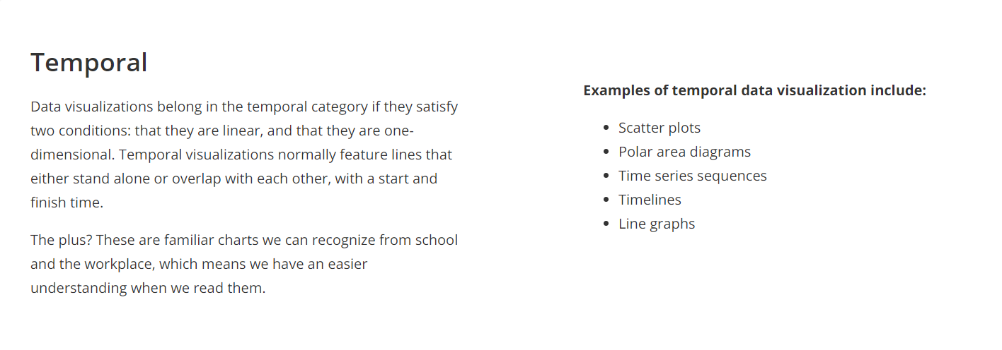
5 Types of Data Visualization Categories :-

Slide 13
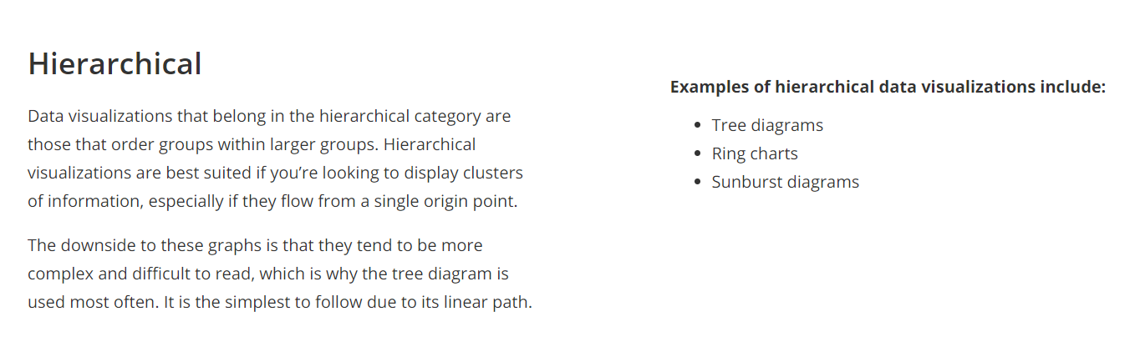
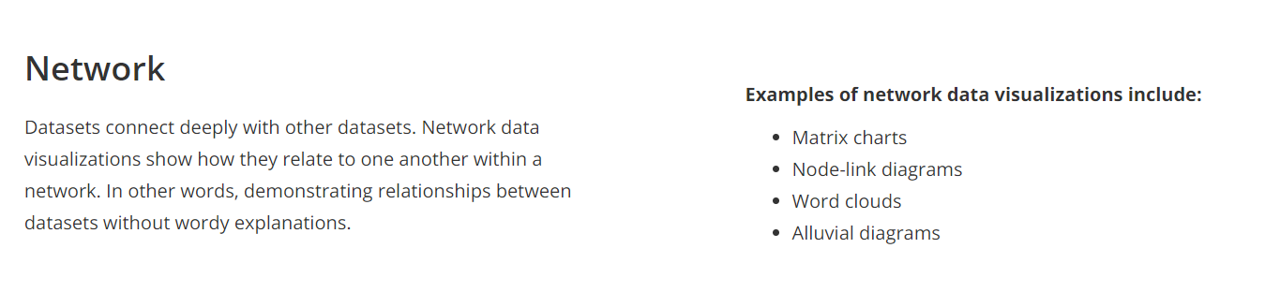

Slide 14
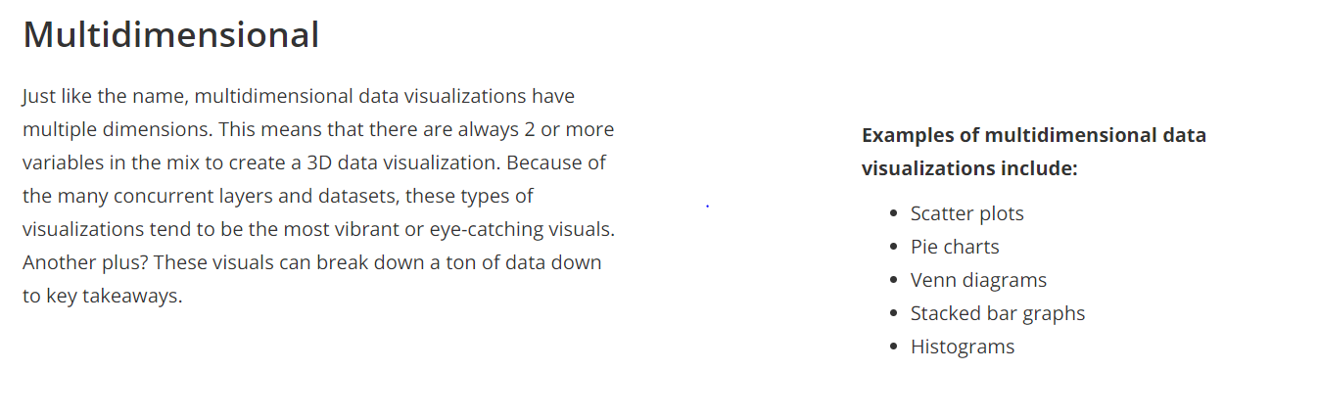
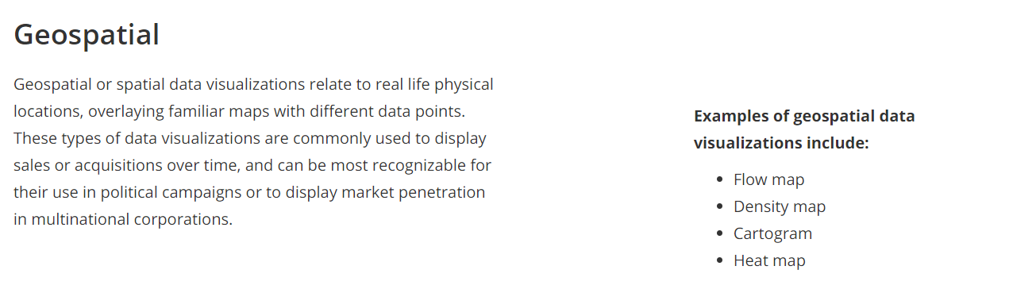

Slide 15
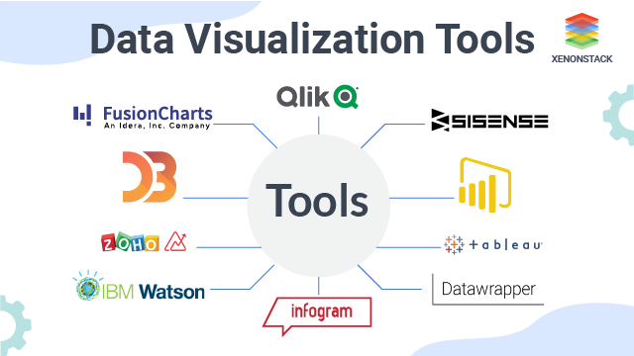

Slide 16

Data Visualization tools :
1. Tableau
One of the most widely used data visualization tools, Tableau, offers interactive visualization solutions to more than 57,000 companies.
Providing integration for advanced databases, including Teradata, SAP, My SQL, Amazon AWS, and Hadoop, Tableau efficiently creates visualizations and graphics from large, constantly-evolving datasets used for artificial intelligence, machine learning, and Big Data applications.
The Pros of Tableau:
Excellent visualization capabilities
Easy to use
Top class performance
Supports connectivity with diverse data sources
Mobile Responsive
Has an informative community
The Cons of Tableau:
The pricing is a bit on the higher side
Auto-refresh and report scheduling options are not available

Slide 17

2. Dundas BI
Dundas BI offers highly-customizable data visualizations with interactive scorecards, maps, gauges, and charts, optimizing the creation of ad-hoc, multi-page reports. By providing users full control over visual elements, Dundas BI simplifies the complex operation of cleansing, inspecting, transforming, and modeling big datasets.
The Pros of Dundas BI:
Exceptional flexibility
A large variety of data sources and charts
Wide range of in-built features for extracting, displaying, and modifying data
The Cons of Dundas BI:
No option for predictive analytics
3D charts not supported

Slide 18
3. JupyteR
A web-based application, JupyteR, is one of the top-rated data visualization tools that enable users to create and share documents containing visualizations, equations, narrative text, and live code. JupyteR is ideal for data cleansing and transformation, statistical modeling, numerical simulation, interactive computing, and machine learning.
The Pros of JupyteR:
Rapid prototyping
Visually appealing results
Facilitates easy sharing of data insights
The Cons of JupyteR:
Tough to collaborate
At times code reviewing becomes complicated

Slide 19

4. Zoho Reports
Zoho Reports, also known as Zoho Analytics, is a comprehensive data visualization tool that integrates Business Intelligence and online reporting services, which allow quick creation and sharing of extensive reports in minutes. The high-grade visualization tool also supports the import of Big Data from major databases and applications.
The Pros of Zoho Reports:
Effortless report creation and modification
Includes useful functionalities such as email scheduling and report sharing
Plenty of room for data
Prompt customer support.
The Cons of Zoho Reports:
User training needs to be improved
The dashboard becomes confusing when there are large volumes of data

Slide 20

5. Google Charts
One of the major players in the data visualization market space, Google Charts, coded with SVG and HTML5, is famed for its capability to produce graphical and pictorial data visualizations. Google Charts offers zoom functionality, and it provides users with unmatched cross-platform compatibility with iOS, Android, and even the earlier versions of the Internet Explorer browser.
The Pros of Google Charts:
User-friendly platform
Easy to integrate data
Visually attractive data graphs
Compatibility with Google products.
The Cons of Google Charts:
The export feature needs fine-tuning
Inadequate demos on tools
Lacks customization abilities
Network connectivity required for visualization

Slide 21

6. IBM Watson
Named after IBM founder Thomas J. Watson, this high-caliber data visualization tool uses analytical components and artificial intelligence to detect insights and patterns from both unstructured and structured data. Leveraging NLP (Natural Language Processing), IBM Watson's intelligent, self-service visualization tool guides users through the entire insight discovery operation.
The Pros of IBM Watson:
NLP capabilities
Offers accessibility from multiple devices
Predictive analytics
Self-service dashboards
The Cons of IBM Watson:
Customer support needs improvement
High-cost maintenance

Slide 22

7. Sisense
Regarded as one of the most agile data visualization tools, Sisense gives users access to instant data analytics anywhere, at any time. The best-in-class visualization tool can identify key data patterns and summarize statistics to help decision-makers make data-driven decisions.
The Pros of Sisense:
Ideal for mission-critical projects involving massive datasets
Reliable interface
High-class customer support
Quick upgrades
Flexibility of seamless customization
The Cons of Sisense:
Developing and maintaining analytic cubes can be challenging
Does not support time formats
Limited visualization versions

Slide 23

8. Plotly
An open-source data visualization tool, Plotly offers full integration with analytics-centric programming languages like Matlab, Python, and R, which enables complex visualizations. Widely used for collaborative work, disseminating, modifying, creating, and sharing interactive, graphical data, Plotly supports both on-premise installation and cloud deployment.
The Pros of Plotly:
Allows online editing of charts
High-quality image export
Highly interactive interface
Server hosting facilitates easy sharing
The Cons of Plotly:
Speed is a concern at times
Free version has multiple limitations
Various screen-flashings create confusion and distraction

Slide 24

9. Data Wrapper
Data Wrapper is one of the very few data visualization tools on the market that is available for free. It is popular among media enterprises because of its inherent ability to quickly create charts and present graphical statistics on Big Data. Featuring a simple and intuitive interface, Data Wrapper allows users to create maps and charts that they can easily embed into reports.
The Pros of Data Wrapper:
Does not require installation for chart creation
Ideal for beginners
Free to use
The Cons of Data Wrapper:
Building complex charts like Sankey is a problem
Security is an issue as it is an open-source tool

Slide 25

10. Power BI
Power BI, Microsoft's easy-to-use data visualization tool, is available for both on-premise installation and deployment on the cloud infrastructure. Power BI is one of the most complete data visualization tools that supports a myriad of backend databases, including Teradata, Salesforce, PostgreSQL, Oracle, Google Analytics, Github, Adobe Analytics, Azure, SQL Server, and Excel. The enterprise-level tool creates stunning visualizations and delivers real-time insights for fast decision-making.
The Pros of Power BI:
No requirement for specialized tech support
Easily integrates with existing applications
Personalized, rich dashboard
High-grade security
No speed or memory constraints
Compatible with Microsoft products
The Cons of Power BI:
Cannot work with varied, multiple datasets

Slide 26
References :-
1. https://www.analyticsinsight.net/communicating-data-decoding-art-data-visualization/
2. https://dzone.com/articles/the-art-of-data-visualization
3. https://www.tableau.com/learn/articles/data-visualization/glossary

